Slide 2
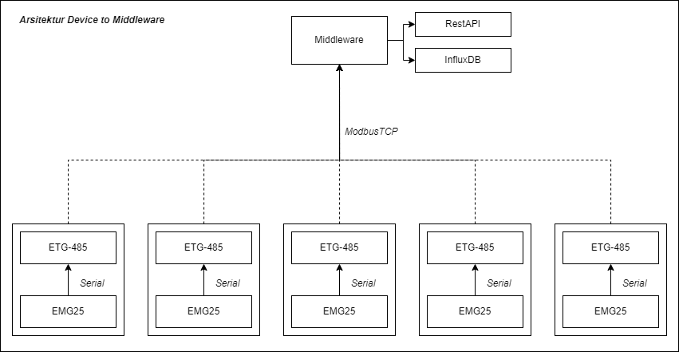
Arsitektur

Slide 3
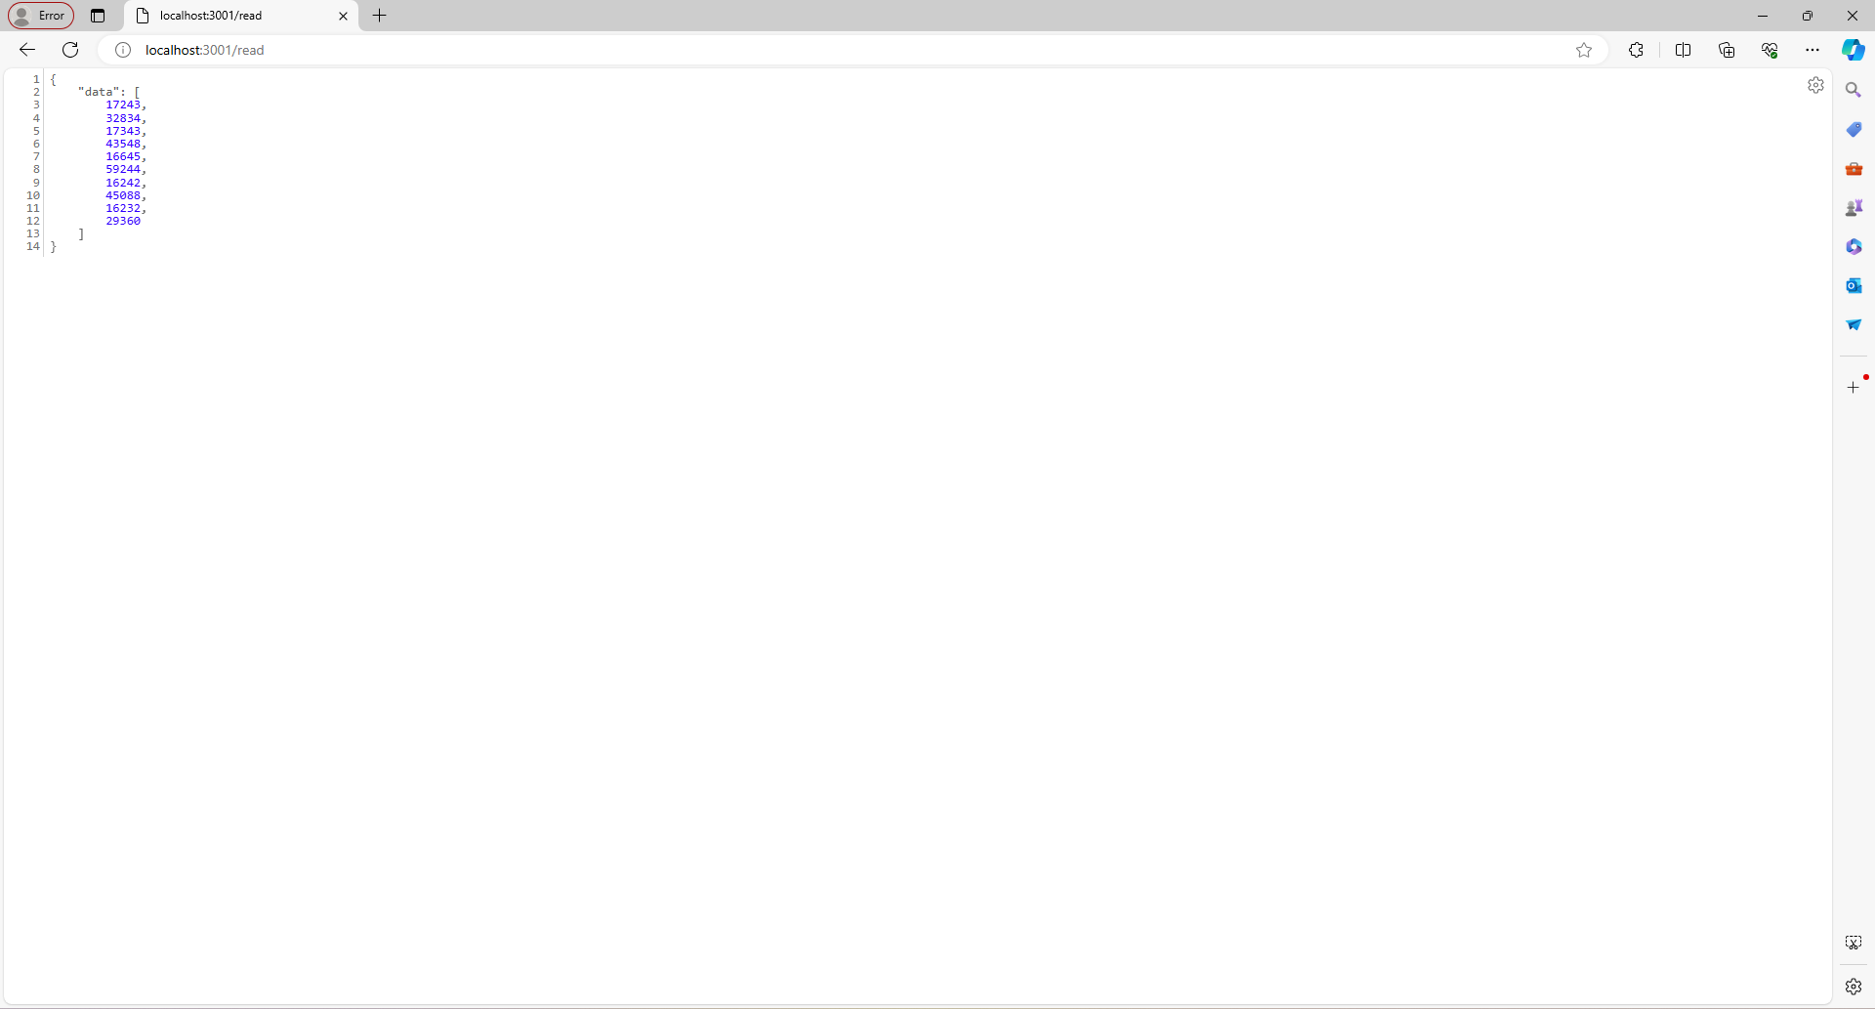
Example data reading ModbusTCP
Address 0-10
0 = V1 (L-N) 16bit ke1
1 = V1 (L-N) 16bit ke2
2 = V1 (L-L) 16 bit ke1
3 = V1 (L-L) 16 bit ke2
4 = I1 16bit ke1
5 = I1 16bit ke2
6 = cos phi1 16 bit ke1
7 = cos phi1 16 bit ke1
8 = Power Factor1 16 bit ke1
9 = Power Factor1 16 bit ke2

Slide 4
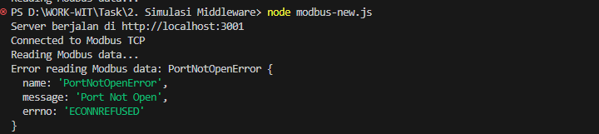
Trouble

Slide 5
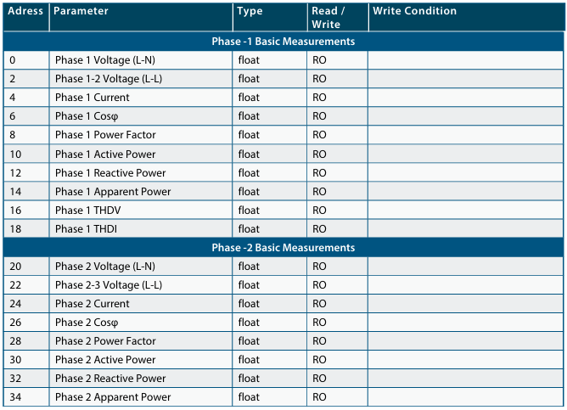
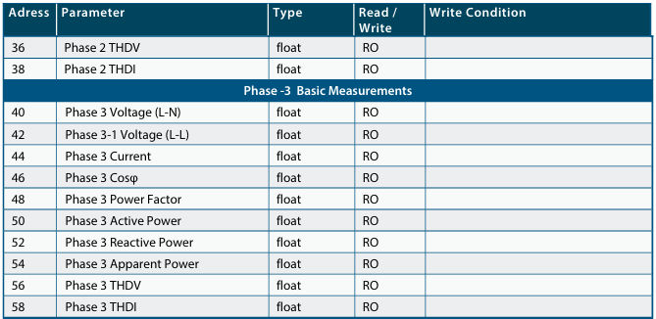
Table Address

